Slide 1


Investment Advisor
Presented by Ayush, Sandeep , Raj aND Jagadeesh

Slide 2

Introduction
A investment advisor is one who provides guidance on how, where, and when to invest. The advice they provide could be for a wholesome ﬁnancial plan or individual investments made towards a larger ﬁnancial plan.
The analysis of the access of Customer Income and Expenses and guide him throughout the particular challenges while guiding him to invest his money for a better future.

Slide 3
Objective
To analyze and understand about stock market [BSE 500] sheet.
To understand the KPI provided for stock selection.
To implement the logics in backend accordingly.
To get familiar with all the stock market terms.
To build an more effective KPI for providing stock suggestions.
To extract the insights with the help of meaningful visuals.

Slide 4
Tools
Python
(Libraries – G-spread, Pandas, Pandas, Numpy)
Google Sheet
Excel

Slide 5
Stock Profiles
1.High Risk Taking
2.Risk Taking
3.Moderate Risk Taking
4.Low Risk Taking

Slide 6
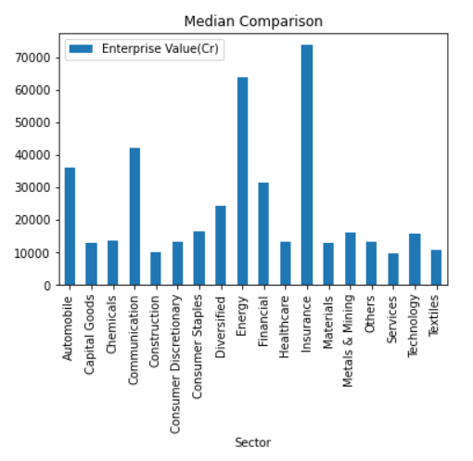
Comparison of enterprise value for all the different sectors
The most booming sectors are insurance and the energy sector followed by communication and automobile
Investing in these sectors can be beneficial for the investors.

Slide 7




Based ON 3 YEARS RETURNS
Top 3 Industry for Investment | Top 3 Industry to avoid
Drugs & Pharma | Banking
Softwar | Fin Services
Cement | Oil Refinery & Marketing

Slide 8

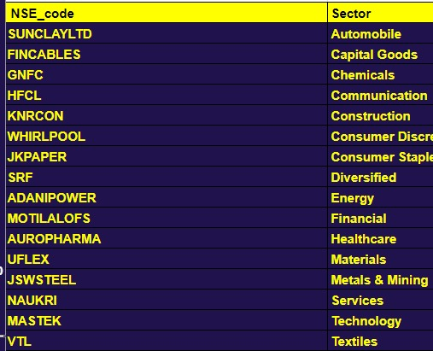



Best Companies Sector to Invest

Slide 9
Personal Data Analysis
expenses
income

Slide 10

Income and expense comparison
Based on the given data the expense are more than the income so this person cannot invest in any company he has to save more to be able to invest in stock market .
Also if we have the passbook of the person with the right data we would be able to tell the person where he can invest in.

Slide 11




Insights
Reliance company has the highest Market cap among the company’s shares.
Sanofi India ltd. Gives the highest dividend to shareholders.
The insurance sector has the highest median enterprise value.
No Relation between Dividend per share and market cap.
Best Companies Sector to Invest.

Slide 12
Challenges
According to the personal profile the person trying to invest does not have any saving for investment
Understanding the data of the stock market
Updating he google straight from python
Understanding API’s
Handling the Json file for requests
Getting Familiar with google requests, gspread syntax. (dropdown has been implemented through python itself).

Slide 13
Learnings
Learnt how we can use google API’s for different purposes.And what are the facilities provided by google.
Learnt how to execute the project by breaking down the problem statements in proper manner.[Proper Mindset]
Learn about stock market using various resources.
Learnt the process about how we can integrate python or any language for solving real world problems.The experience was amazing.

